Slide 1
EMSL 50209 Weintraub NOM Samples on 15T FT-ICR
Sample Preparation: Jesse Trejo
Measurements: Rosey & Jason 23 Dec. 2020
Data Analysis: Nikola 25 Feb. 2021
Sample stats: Rosey March 2021

Slide 2
Experimental Set-up and extraction
Sample Prep:
See separate word document for Jessie’s Mplex prep.
Upper M-Mplex samples were cleaned up by SPE (M-MpleX_SPE). There was a lot of FeCl and Cl clusters in the non SPE’ed samples suppressing ionization and therefore significantly less assignments. The excel file has only the samples that were SPE’ed.
This upper fraction, M-MpleX, was split with GC-MS before clean-up.
Lower L-Mplex samples were diluted 1:1 with MeOH. This fraction was split with lipidomics. After data evaluation we ran this sample set again for better results in March 2021.
Instrument Settings:
Samples were infused into the 15T FTICR by an automated direct injection system at a flow rate of 4ul/min.
Samples were co-added for 300 scans, 100Da to 900Da.
Spectra were inspected and reruns were appended to the queue.
Data analysis:
Samples were peak picked using Bruker DA software with a S/N =7.
Data were calibrated and formula assigned using in house software Formularity. Greater details on slide 7.
Slides 3 to 7 describe the QC metrics and how the Cl adducts were assigned to give greater confidence to CHOP and CHON assignments.

Slide 3
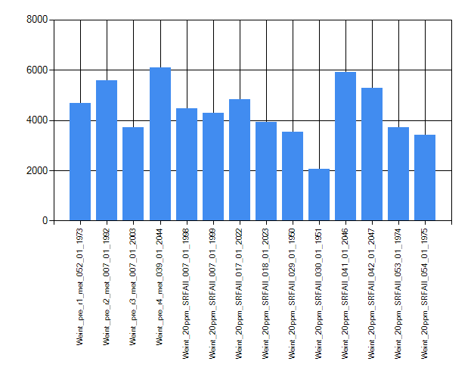
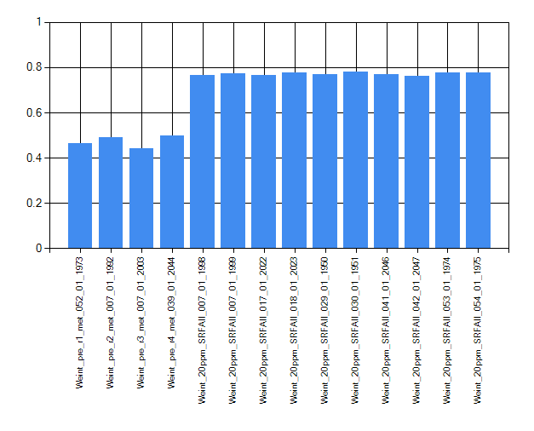
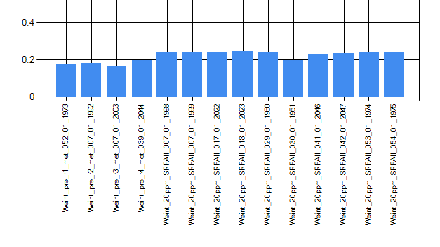
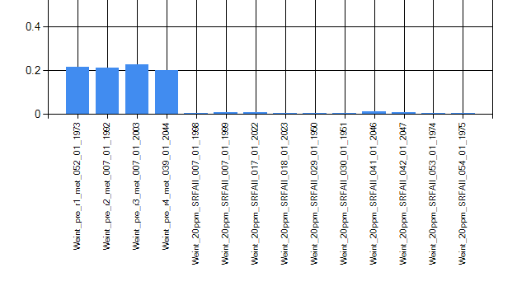
peak counts (s/n>=7)
SRFA & pre_r1-4 spectra - QC metrics
SRFA looks good; Control soil pre_r1-4 contain an abundance of Cl clusters. These Cl clusters are originating from the samples. This is true for all the samples in this study. Making formula assignment challenging.
CH₂
¹²C-¹³C; no multi charged ions
³⁵Cl-³⁷Cl
dm= 28.0311 ( 2(CH₂))
Neg.ESI – m/z 365.24, 393.277 with Cl isotopic signature
[C₁₉H₃₈O₄+Cl]⁻ , [C₂₁H₄₂O₄+Cl]⁻

Slide 4
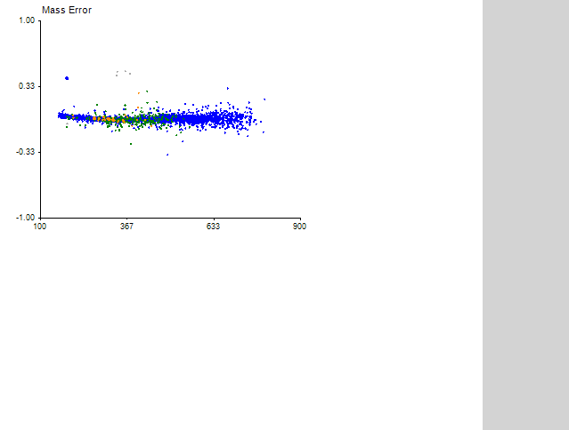
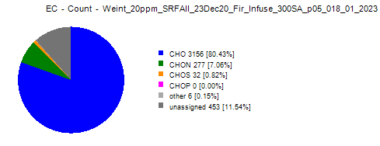

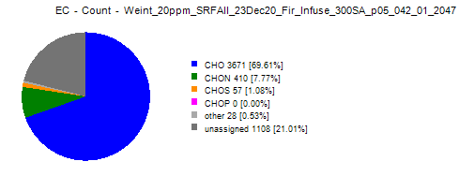


More QC Metrics
SRFA Formula Assignment
Looks good; Mass error pattern looks good.

Slide 5
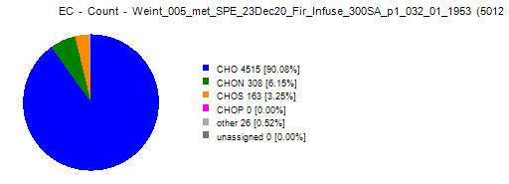

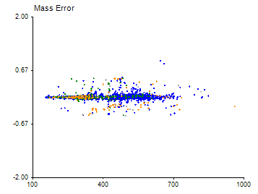
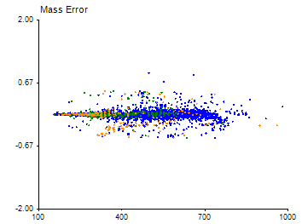


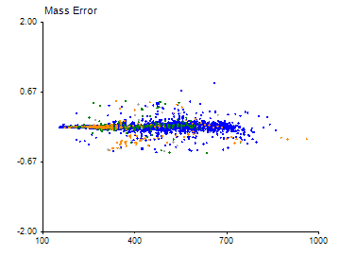

Met – SPE Spectra
Mass Error; Assigned NOM Formula

Slide 6
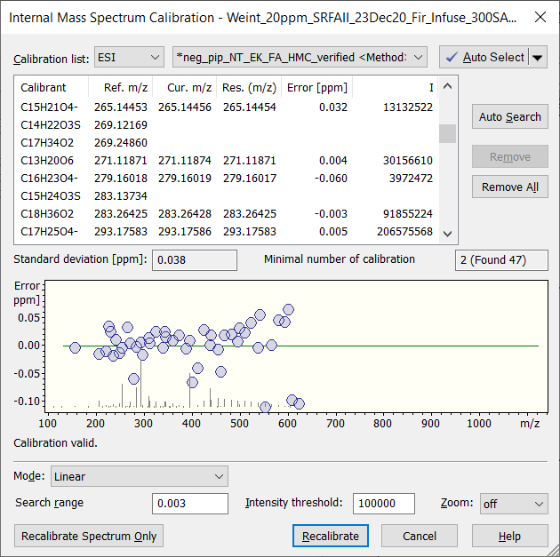
MMA in SRFA better than 1 ppm around m/z 300 before internal calibration

Slide 7
Data processing and formula assignment
Peak extraction by DataAnalysis software (Bruker); s/n>=7
(spectra complexity makes it unlikely that anything after 600 can be assigned unambiguously)
Formula Assignment with Formularity software:
Custom calibration list, quadratic regression, start 5 ppm, target 0.35 ppm (details in Excel report)
CIA search [M-H]-; 0.5 ppm O>0 AND N<3 AND S<2 AND P=0
CIA search [M+Cl]-; 0.5 ppm O>0 AND (N+S)<2 AND P=0
Ambiguous assignment resolved using “simpler formula” criteria;
NaCl clusters assigned using Formularity IPA function (results manually merged with CIA report)
EUP50209_NOM_Met_SPE_MFAssignment.xlsx file contains results with multiple worksheets
Calibration_Details - details of calibration for each dataset
Calibration_Summary - summary of before and after calibration for each dataset
Full_Report - full report of aligned peaks and assigned formula with peak abundance in each sample
xtra_MF_NOM - NOM assigned formula with added calculated columns (this is subset of Full_Report)
xtra_MF_NOM_Mono - NOM assigned formula with isotopic peaks removed

Slide 8
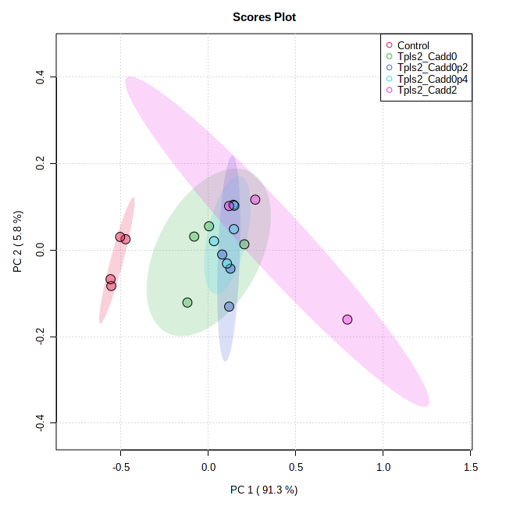
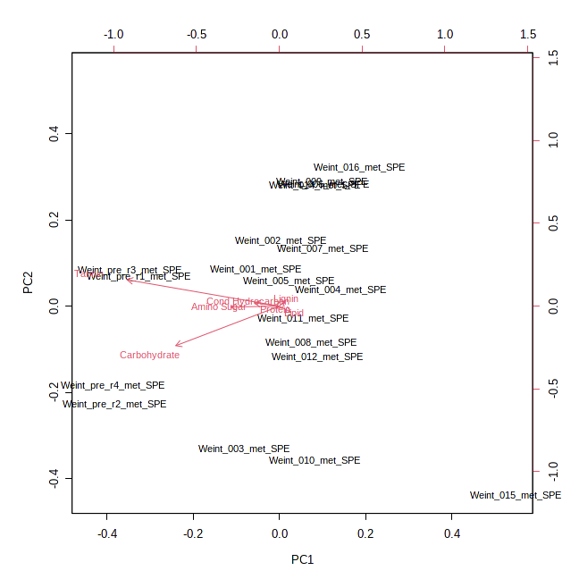
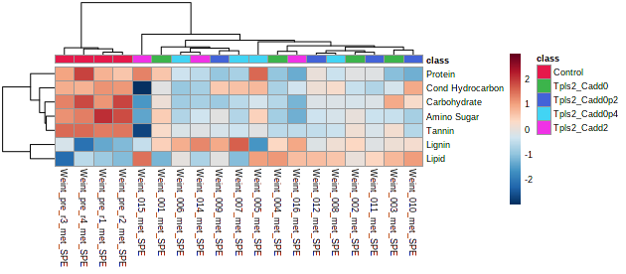
PCA of M-Mplex (SPE) Samples – Tpls2-Class
To deep dive the data you will need to focus on the unique formula assignments. Sample 13 was removed as an outlier

Slide 9
For further statistical processing and visualization:
https://msc-viz.emsl.pnnl.gov/FREDA/
Bramer, L. M., White, A. M., Stratton, K. G., Thompson, A. M., Claborne, D., Hofmockel, K., & McCue, L. A. (2020). ftmsRanalysis: An R package for exploratory data analysis and interactive visualization of FT-MS data. PLoS computational biology, 16(3), e1007654.

